Slide 1
Predicting Data Breaches with Machine Learning: A Focus on Data Type and Vulnerabilities
Yuta Sugiyama
2023.11.28
CDS-492 | Fall 2023 | Dr. Slamani
Notes:
Hi everyone! Hope you all are having a good end of the semester, I'm excited to share with you my findings of my research project on predicting data breaches in Massachusetts using machine learning and data science techniques.

Slide 2
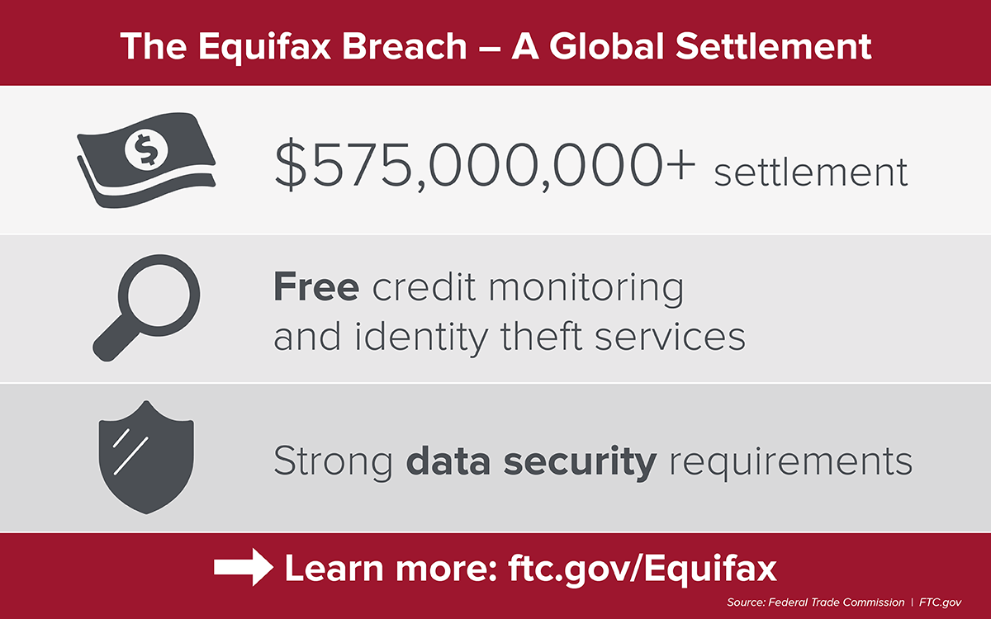
Introduction
Problem description
In the realm of our current efforts in cybersecurity, data breaches have become a common threat, with their frequency and impact on the rise. These breaches happen when unauthorized individuals access private information, causing financial losses, damage to reputations, and legal issues for the people and organizations involved.
Real-world Example
The motivation is exemplified by the 2017 Equifax data breach, compromising sensitive information of 148 million Americans, leading to substantial financial losses, identity theft concerns, and severe damage to Equifax's reputation.
Notes:
As you all might know by either reading news articles or watching the news from time to time, data Breaches have emerged as a significant threat in today's digital world, impacting organizations and individuals alike.
These breaches happen when unauthorized individuals access private information, causing financial losses, damage to reputations, and legal issues for the people and organizations involved.
This research project aims to predict and categorize organized data breaches by looking at the type of personal information they target. It also seeks to identify the susceptibility of organizations being breached, and where these breaches are more likely to occur.
The motivation from this project comes from the recent increase of data breach occurrences and the severity.
One case of one of these severe data breaches is the 2017 Equifax data breach, where the sensitive personal information, including names, addresses, social security numbers, and credit card details of 148 million Americans were compromised.
This occurred due to a combination of vulnerabilities in Equifax's cybersecurity infrastructure, network, and back-end databases, and the exploitation of these weaknesses by Chinese military-backed hackers.

Slide 3
Introduction
Research Questions
Are certain types of organizations more prone to data breaches than others?
How effective are strategies like Data Encryption and Credit Monitoring in preventing or reducing the impact of data breaches?
Can the predictions from our research reveal patterns and motivations behind organized data breaches, offering insights into their targets?

Slide 4
Introduction
Objectives
To analyze and evaluate the vulnerability of different types of organizations to data breaches, considering factors that make them more susceptible.
To assess the effectiveness of data protection strategies, particularly focusing on Data Encryption and Credit Monitoring.
To gain a comprehensive understanding of the patterns and motivations behind organized data breaches, providing valuable insights into their targets and how they are executed.

Slide 5




Benefits of this Study
Localized Risk Assessment
Targeted Resource Allocation
Stakeholders can identify regions that are at a higher risk of data breaches.
Cybersecurity personnel, tools, and budgets can be allocated more efficiently.
Improving Regulations and Policies
Targeted Security Measures
Policy makers can develop and enhance regulations and policies, addressing vulnerabilities.
Understanding organizations and data types with higher risks, can help implement security.
Notes:
The tangible benefits that this study of predicting data breaches will bring a Localized Risk Assessment, Targeted Resource Allocation, Improving Regulations and Policies, and Targeted Security Measures.
Our machine learning model enables stakeholders to pinpoint regions at a higher risk of data breaches. By identifying localized vulnerabilities, proactive and more efficient measures can be taken to fortify cybersecurity defenses.
Cybersecurity resources, including personnel, tools, and budgets, can be allocated with greater precision. This targeted approach ensures that efforts are concentrated where they are needed the most, maximizing the efficiency of resource utilization.
For policymakers, the findings from this study can be leveraged to develop and enhance regulations and policies, creating a more robust framework to address vulnerabilities and protect sensitive information.
Armed with an understanding of which organizations and data types are at higher risk, cybersecurity measures can be tailored accordingly. This targeted approach allows for the implementation of specific security protocols and measures to address identified risks.

Slide 6
Review of Previous Work
01
02
03
Literature Review 1
Literature Review 2
Literature Review 3
The paper analyzes a 6-year sample from the Privacy Rights Clearinghouse to explore correlates of data loss and spatial distribution of lost records in the United States, using advanced spatial analysis techniques to discuss vulnerabilities and explore policy implications.
This study on the 2012 South Carolina Department of Revenue data breach finds that directly affected consumers protected themselves by monitoring files and freezing credit reports yet maintained usual credit card use and lender loyalty; those exposed only to news about the breach showed minimal response.
The paper proposes an interactive visualization tool using the 2021 VAST Challenge dataset to educate lay users about the risks of data breaches, particularly in clinical research, aiming to empower them with knowledge for better protection of personal information.
Notes:
Literature Review 1 examines a 6-year dataset from the Privacy Rights Clearinghouse, utilizing advanced spatial analysis techniques to explore correlations of data loss and the spatial distribution of lost records in the United States. The study provides insights into vulnerabilities and spatial patterns, emphasizing the importance of spatial considerations in assessing data breach risks.
Literature Review 2:
Focusing on the aftermath of the 2012 South Carolina Department of Revenue data breach, this study analyzes the responses of directly affected consumers. This literature emphasizes behavioral responses to data breaches, assisting our study on the effectiveness of data protection strategies and offering nuance into the impact of these breaches.
Literature Review 3 introduces an interactive visualization tool using the 2021 VAST Challenge dataset to educate lay users, particularly in clinical research, about the risks of data breaches. This literature review highlights the significance of visualization tools in conveying complex information about data breaches to non-experts.

Slide 7
Data
Description
Source
State of Massachusetts Office of Consumer Affairs and Business Regulation.
File
The Original PDF reports transformed into a consolidated .csv file (2007-2022). Isolation of the 2023 dataset to compare with the predictive model.
Period | 2007-2023
File Size | 1.5MB
Rows | 22994
Columns | 13
Notes:
The dataset chosen is from the state of Massachusetts (MA) Office of Consumer Affairs and Business Regulation website, holding reports of data breaches from 2007 to 2023 [1].
The dataset reports of each year were in PDF format, so the reports were consolidated into a single .csv file, featuring data from 2007 to 2022.
The original dataset consists of 13 columns and 22,994 rows, totaling 1.5MB [1].
The 2023 dataset was isolated for comparison with the predicted model.

Slide 8
Data Columns
Column | Data Type | Description
Assigned Breach Number | Numerical | A unique identifier for each data breach incident
Date Reported | Date | The date when the data breach occurred.
Organization Name | Categorical | The name of the business or organization affected by the data breach.
Breach Type Description | Categorical | The format in which the data was compromised, such as "Electronic" or "Paper.”
Breach Occurrence at Reporting Entity? | Boolean | Whether the breach occurred at the reporting entity.
MA Residents Affected | Numerical | How many Massachusetts residents were affected by this breach.
SSN Breached? | Boolean | Whether Social Security Numbers (SSNs) were compromised, with values like "Yes" or empty cells.
Account Number Breached? | Boolean | Whether account numbers were compromised.
Driver’s Licenses Breached? | Boolean | Whether driver’s license numbers were compromised.
Credit Debit Numbers Breached? | Boolean | Whether credit/debit card numbers were compromised.
Provided Credit Monitoring | Boolean | Whether the organization offers credit monitoring to individuals/ consumers.
Data Encrypted | Boolean | Whether data was encrypted or not for that organization.
Mobile Device Lost Stolen | Boolean | Whether mobile device was lost or stolen.

Slide 9
Computational Techniques
Natural Language Processing
Normalization and Denormalization
GridSearchCV
01
03
05
Employed for Organization Categorization
Utilized for hyperparameter tuning to find the best hyperparameters
Scales the features of the data, then conveyed result in the original dataset’s units.
Decision Tree Classifier
Outlier Detection and Handling
RandomUnderSampler
02
04
06
Detection was performed using the IQR method and those outliers were removed
Helps understand how features are utilized to make predictions.
Employed to address class imbalance, by randomly removing instances from the majority class.
Notes:
Decision Tree Classifier: The Decision Tree Classifier was employed to predict data breaches based on various features to understand how different features contribute to the model's decision-making process.
Natural Language Processing (NLP): NLP was used for organization categorization based on the "Organization Name" column , creating a "Organization Categories" column with categorical values reflecting different types of organizations. A challenge emerged which involved dealing with a large number of unique keywords (~8000). I will elaborate on this challenge in the results section.
Outlier Detection and Handling. The Inter-Quartile Range (IQR) method was employed for outlier detection. Rows containing outliers were removed to ensure the model's focus on the average amount of cases of data breaches.
Normalization and Denormalization: Normalization was applied to scale data features consistently, preventing any single feature from dominating the model. Denormalization was performed post-training for a more intuitive understanding of predictions based on the context of specific data breach attributes. Scaling features ensures that no particular feature has a disproportionate impact on the model due to differences in scale.
RandomUnderSampler: Addressed the class imbalance in the dataset. The RandomUnderSampler was used to randomly remove instances from the majority organization class. This ensured a more balanced distribution of classes during training, preventing bias towards the majority class, especially when dealing with minority classes like "Healthcare.”
GridSearchCV:. GridSearchCV systematically tests a range of hyperparameter values to identify the combination that maximizes the model's performance on the training data.

Slide 10
Validation Methods
GridSearchCV
A technique for hyperparameter tuning that involves defining a grid of hyperparameter values and searching through the grid to find the combination that yields the best model performance.
Cross-validation
Divides the training dataset into subsets (folds). The model is trained and evaluated on different combinations of hyperparameters for each fold, and the average performance is calculated.
Notes:
Hyperparameters were tuned with the max depth (set at 5), minimum samples at leaf nodes (set at 4), and minimum samples to split internal nodes (set at 2), values that maximized performance on the training data. This method helps in fine-tuning the model by systematically searching through a predefined set of hyperparameter values, leading to improved model performance.
In this study, cross-validation was applied during the training phase. The dataset was divided into multiple folds, and the model has been trained and validated on different combinations of these folds. This helps in assessing the model's performance on different subsets of the data, which reduces the risk of overfitting to a specific training-validation split.

Slide 11
Results
Training Accuracy | 0.57
Testing Accuracy | 0.64
 | Precision | Recall | F1-Score | Support
Finance | 0.67 | 0.72 | 0.69 | 2462
Healthcare | 0.52 | 0.28 | 0.36 | 2462
Other | 0.51 | 0.71 | 0.59 | 2462
accuracy |  |  | 0.57 | 7386
macro avg | 0.57 | 0.57 | 0.55 | 7386
weighted avg | 0.57 | 0.57 | 0.55 | 7386
 | Precision | Recall | F1-Score | Support
Finance | 0.80 | 0.70 | 0.75 | 2737
Healthcare | 0.27 | 0.28 | 0.27 | 800
Other | 0.61 | 0.70 | 0.65 | 2053
accuracy |  |  | 0.64 | 5590
macro avg | 0.56 | 0.56 | 0.56 | 5590
weighted avg | 0.65 | 0.64 | 0.64 | 5590
Notes:
In our results we have our classification reports which provide the detailed breakdown of the model's performance on both the training and testing datasets.
The decision tree classification model achieved an accuracy of approximately 57% on the training set, correctly predicting class labels for instances in the "Finance" category with 67% precision and 72% recall, resulting in a balanced F1-score of 69%. However, it faced challenges in predicting "Healthcare" organizations with 52% precision, 28% recall, and an F1-score of 36%, indicating a trade-off between false positives and missed instances. For the "Other" category, the model achieved a moderate precision (51%) and recall (59%), indicating a balance performance.
In the testing dataset, the model demonstrated a 64% accuracy, maintaining consistent results with the training dataset. It performed well in predicting "Finance" organizations, achieving high accuracy (80%) with balanced precision (70%) and recall, resulting in a well-balanced F1-score of 75%. However, challenges persisted in predicting "Healthcare" organizations, with lower precision (27%), recall (28%), and an F1-score of 27%. The model achieved a moderate level of accuracy for the "Other" category with 61% precision and 70% recall, also indicating a balanced performance for this class.
Overall, the results indicate consistent performance of our model in our train and test datasets, with a particular emphasis on refining the model's ability to identify "Healthcare" instances accurately.

Slide 12
Conclusion
Model Performance
Challenges in NLP
Data Protection Strategies
Future Directions
Demonstrated strong performance in identifying finance organizations.
Low precision and recall for Healthcare and Other organization classes.
Manually categorizing organizations by their names due to a high number of unique keywords.
Budget constraints from the use of Google's API for automation.
There is significance in protecting credit and debit card information.
There is significance in providing credit monitoring security measurers.
More practical approaches to categorizing organizations using NLP.
Recommendations include downsizing the project for specific financial institutions.

Slide 13
Works Cited
Commonwealth of Massachusetts, “Data breach reports,” Mass.gov. Commonwealth of Massachusetts, 2023.
Available: https://www.mass.gov/lists/data-breach-reports
E. P. I. Center, “Equifax Data breach,” Electronic Privacy Information Center (EPIC), 2023. Available:
https://archive.epic.org/privacy/data-breach/equifax/.
Khey, D. N., & Sainato, V. A. (2013). Examining the correlates and spatial distribution of organizational data
breaches in the United States. Security Journal, 26(4), 367–382. https://doi.org/10.1057/sj.2013.24
Mikhed, V., & Vogan, M. (2018). How data breaches affect consumer credit. Journal of Banking and Finance, 88, 192–
207. https://doi.org/10.1016/j.jbankfin.2017.12.002
Carr, R. Modified VAST Challenge with Applications to Data Breaches. Challenge, 2, 9.

